Slide 1
Lesson 4 Normalisation
T Myran

Slide 2
L4 - Syllabus Links
A3.2.5 Explain the difference between normal forms.
First normal form (1NF), second normal form (2NF), third normal form (3NF)
The terms atomicity, unique identification, functional dependencies, partial-key dependencies, non- key/transitive dependencies
Normalization issues can encompass data duplication, missing data, and a range of dependency concerns, including data dependencies, composite key dependencies, transitive dependencies, and multi-valued dependencies.
A3.2.7 Evaluate the need for denormalizing databases.
The advantages and disadvantages of normalizing and denormalizing databases
Situations where denormalization can enhance performance, particularly in read-intensive applications
The balance between straightforward query structures and the risk of data redundancy in denormalized schemas

Slide 3
Lesson 4 Normalisation
Define the key terms of normalisation, including atomicity, unique identification, functional, partial-key and explain how they relate to data integrity.
Apply the rules of 1NF, 2NF, and 3NF to identify and resolve normalisation issues such as data duplication
Evaluate the trade-offs between normalisation and denormalisation

Slide 4

Data normalisation…
…represents the process of organising data in a relational database in a way to reduce data redundancy and to improve data integrity.

Slide 5

Redundancy and Integrity
Data redundancy is reduced as each item of data only occurs in one location in the database. This can reduce the possibility of update anomalies occurring (data integrity), and it makes more etticient use of memory .
NOTE: Typically, data redundancy is a good thing, in areas such as disaster recovery as having multiple copies of data means you can safely restore any lost data. Within the DB, however, this is bad!

Slide 6
Normalisation…
Leads to smaller tables with less information in each row, which leads to a reduction of input / output transfers
CPU can work at full capacity since the likelihood of CPU activities being suspended is reduced.
Is achieved through a series of stages called “normal forms”, where each normal form has specific requirements for the table to be normalised at that level.

Slide 7
1NF: What must a table have?
For a table to be in First Normal Form (1NF), it must:
✓ Have a primary key (identifies each record uniquely)
✓ Have no duplicate attributes (each column has unique name)
✓ Have no repeating groups (no multiple values in one cell)
✓ Have atomic values (data cannot be broken down further)
Think: What happens if TeacherName contains "John Smith"?

Slide 8
Atomicity: Breaking Down Data
Atomic = "indivisible" - each cell contains a single value
NOT Atomic:
TeacherName: "John Smith" ✗ (can be split into FirstName, LastName)
PhoneNumbers: "123-4567, 234-5678" ✗ (multiple values)
Atomic:
FirstName: "John" ✓
LastName: "Smith" ✓
PhoneNumber: "123-4567" ✓
Question: Why is atomicity important for data integrity?

Slide 9
Functional Dependencies
Discuss: In pairs, identify the functional dependency in your TEACHER table
A relationship where one attribute determines another
Determinant → Dependent
Example (STUDENT table):
StudentID → FirstName, LastName, DateOfBirth, Email
Types of Functional Dependencies:
1. Full: Dependent fully determined by determinant
2. Partial: Dependent only partially determined (problem in composite keys)
3. Transitive: Non-key depends on another non-key

Slide 10
Check for Understanding: 1NF
Answer these questions (Think-Pair-Share):
1. Which of these violates 1NF?
a) StudentID: 12345
b) Courses: "Math, Science, English"
c) Age: 16
2. True or False: "Maria Rodriguez" is atomic data
3. What makes this problematic: TeacherSubjects: "Math, Physics"?
4. Give an example of a functional dependency from a COURSE table
Be prepared to explain your reasoning!

Slide 11
ANSWERS
1. Which violates 1NF? → b) Courses: "Math, Science, English" This cell contains multiple values in a single field, violating the atomicity rule of 1NF. Options a) and c) are single, indivisible values and are fine.
2. True or False: "Maria Rodriguez" is atomic data → False "Maria Rodriguez" can be broken down further into FirstName: "Maria" and LastName: "Rodriguez". To satisfy atomicity (and therefore 1NF), these should be stored in separate columns.
3. What makes TeacherSubjects: "Math, Physics" problematic? It stores multiple values in one cell (a repeating group), which violates 1NF. This makes it impossible to query, sort, or filter individual subjects without parsing the string. The fix is to split into separate rows, e.g. one row per subject per teacher.

Slide 12
ANSWERS
4. Example functional dependency from a COURSE table:
CourseID → CourseName, TeacherID, RoomNumber
CourseID is the determinant — knowing the CourseID uniquely determines all other attributes in the COURSE table. Students could also suggest:
CourseID → CourseName
CourseID → TeacherID
Both are valid partial examples of the same full functional dependency.

Slide 13
Second Normal Form (2NF)
Building on 1NF - A table is in 2NF if:
✓ It is already in 1NF (meets all 1NF requirements)
✓ All non-key attributes are FULLY functionally dependent on the PRIMARY KEY
✗ No partial dependencies (when using composite keys)
Key Problem: Partial Dependency
- Occurs when non-key attributes depend on PART of a composite key
- Solution: Split the table!
Question: Why is this a problem for data integrity and redundancy?

Slide 14
2NF Example: CLUB Table Problem
CLUB table (NOT in 2NF):
Primary Key: (ClubTitle, StudentID) - COMPOSITE KEY
Problem: TeacherName depends on ClubTitle only (partial dependency)
- NOT on the full composite key (ClubTitle + StudentID)
ClubTitle | StudentID | TeacherName
Robotics | 1001 | Myran
Robotics | 1002 | Myran
Football | 1003 | Frans
Solution - Split into 2 tables:
CLUB_ENROLLMENT: (ClubTitle, StudentID)
CLUB_DETAILS: (ClubTitle, TeacherName)
Now in 2NF! ✓

Slide 15
Check for Understanding: 2NF
1. What must be true before a table can be in 2NF?
2. Given: ENROLLMENT(CourseID, StudentID, CourseName, Instructor)
Primary Key: (CourseID, StudentID)
What is the problem with CourseName and Instructor?
3. How would you split this table to achieve 2NF?
4. Why does 2NF only matter when you have composite keys?
Share your answers with the class!

Slide 16
Third Normal Form (3NF)
The highest level of normalisation - A table is in 3NF if:
✓ It is already in 2NF (meets all 2NF requirements)
✓ All non-key attributes are independent of each other
✗ No transitive dependencies
Key Problem: Transitive Dependency
- When a non-key attribute depends on ANOTHER non-key attribute
- Instead of depending directly on the primary key
Example: EmployeeID → DepartmentID → DepartmentName
(DepartmentName transitively depends on EmployeeID)
Question: How does removing transitive dependencies reduce data redundancy?

Slide 17
3NF Worked Example: CLUB Table
CLUB table in 2NF (but NOT in 3NF):
Primary Key: ClubID
Problem: TeacherLastName depends on TeacherID (transitive dependency)
- TeacherID is NOT the primary key
Solution - Split into 2 tables:
CLUBDETAILS: (ClubID, ClubTitle, TeacherID)
TEACHERDETAILS: (TeacherID, TeacherLastName)
ClubID | ClubTitle | TeacherID | TeacherFName
105 | Robotics | 1 | Myran
202 | Football | 2 | Frans
106 | Arts & Crafts | 3 | Jane
109 | Chess | 1 | Myran
Now in 3NF! ✓ Data redundancy eliminated!

Slide 18
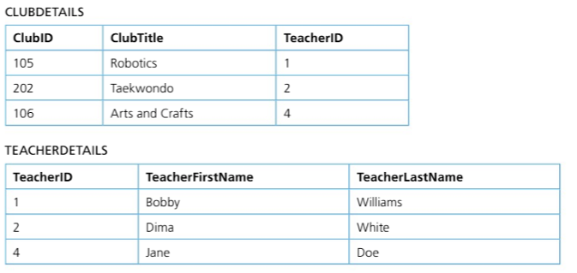

Slide 19
Check for Understanding: 3NF
Group Activity - Analyse this table:
PROJECT(ProjectID, ProjectName, ManagerID, ManagerName, ManagerDept)
1. Is this table in 1NF? Why or why not?
2. Is this table in 2NF? Explain.
3. Is this table in 3NF? If not, identify the transitive dependency.
4. How would you restructure this to achieve 3NF?
5. Compare: What are the benefits of normalizing to 3NF?
Present your solution!

Slide 20
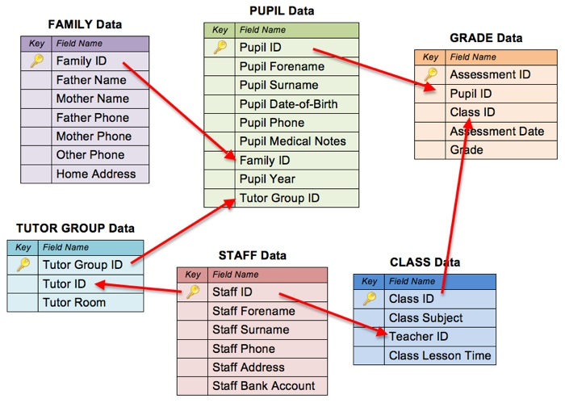
Class Discussion: Why Normalise?
Real-world application
Where would you use normalisation in a school database?
Reflect on what we've learned - Discuss as a class:
1. What problems does normalisation solve?
- Data redundancy
- Update anomalies
- Insertion anomalies
- Deletion anomalies
2. What's the trade-off?
- More tables = more complex queries (need JOIN operations)
- Performance considerations
3. When might you NOT normalise to 3NF?
- Read-heavy applications
- Data warehousing scenarios

Slide 21
Normalising Databases
Normalisation is the process of organising a database to reduce data redundancy and improve data integrity.
Key goals:
Eliminate duplicate data (e.g., the same author name stored in multiple places)
Ensure data is stored logically in separate, related tables
Make the database easier to maintain and scale
A fully normalised database follows rules called Normal Forms: 1NF → 2NF → 3NF

Slide 22
Pros & Cons of Normalising
✅ Advantages | ❌ Disadvantages
Reduces data redundancy: less storage waste | Complex schema with many tables: harder to understand
Ensures data integrity: insert/update/delete stay consistent | Increased query complexity: more JOINs needed
Supports efficient data retrieval | More storage used for extra tables & relationships
Easier to scale: add new data without restructuring | Not ideal for all use cases (e.g. real-time analytics)
Simplifies maintenance: change one table, not many | Over-normalisation can hurt performance

Slide 23
Denormalising Databases
Denormalisation is the deliberate process of adding back redundancy into a database to improve read/query performance.
Why would we do this?
Sometimes speed matters more than perfect structure:
When to Denormalise | Why It Helps
Read-intensive applications | Fewer JOINs = faster data retrieval
Reporting & analytics | Simpler queries across large datasets
Data warehousing | Historical data accessed quickly without complex joins

Slide 24
Pros & Cons Denomalisation
✅ Advantages | ❌ Disadvantages
Faster query performance | Data redundancy: risk of inconsistencies
Simpler data retrieval | Increased storage overhead
Better scalability for large datasets | Harder to maintain and update
⚠️ Finding the right balance between normalisation and denormalisation depends on your application's needs.

Slide 25
🧠 Quick Check: Normalisation & Denormalisation
Question 1: What is the main purpose of normalising a database?
A) To speed up read queries
B) To reduce data redundancy and improve data integrity
C) To combine all data into a single table
D) To remove all relationships between tables
Question 2: Which of the following is a disadvantage of normalisation?
A) Data is stored in multiple places
B) Increased query complexity due to multiple JOINs
C) Faster updates because all data is in one table
D) Data redundancy causes inconsistencies

Slide 26
🧠 Quick Check: Normalisation & Denormalisation
Question 1: What is the main purpose of normalising a database?
A) To speed up read queries ❌
B) To reduce data redundancy and improve data integrity ✅
C) To combine all data into a single table ❌
D) To remove all relationships between tables ❌
Question 2: Which of the following is a disadvantage of normalisation?
A) Data is stored in multiple places ❌
B) Increased query complexity due to multiple JOINs ✅
C) Faster updates because all data is in one table ❌
D) Data redundancy causes inconsistencies ❌

Slide 27
🧠 Quick Check: Normalisation & Denormalisation
Question 3: A company runs a dashboard that only reads data and never updates it. Should they consider denormalisation?
A) No — normalisation always performs better
B) Yes — denormalisation improves read-heavy query performance
C) No — denormalisation only works for small databases
D) Yes — denormalisation removes all data from the database
Question 4: Which scenario is BEST suited for denormalisation?
A) A student registration system that updates daily
B) A real-time inventory system
C) A data warehouse storing historical sales reports
D) A banking system that handles frequent transactions

Slide 28
🧠 Quick Check: Normalisation & Denormalisation
Question 3: A company runs a dashboard that only reads data and never updates it. Should they consider denormalisation?
A) No — normalisation always performs better ❌
B) Yes — denormalisation improves read-heavy query performance ✅
C) No — denormalisation only works for small databases ❌
D) Yes — denormalisation removes all data from the database ❌
Question 4: Which scenario is BEST suited for denormalisation?
A) A student registration system that updates daily ❌
B) A real-time inventory system ❌
C) A data warehouse storing historical sales reports ✅
D) A banking system that handles frequent transactions ❌

Slide 29
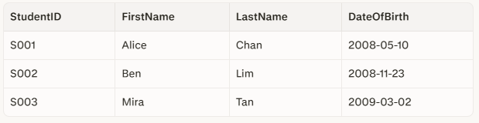
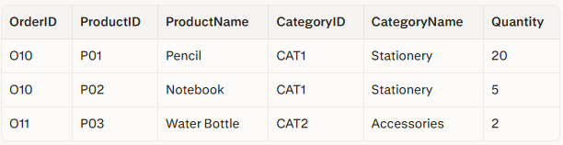
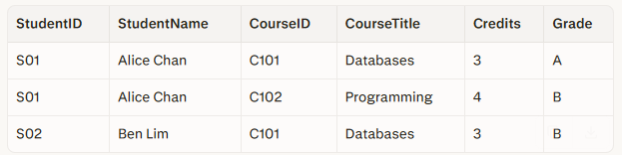
Plenary:
⭐ Exit Ticket:
On a scale of 1-5, how confident are you?
1 □ 2 □ 3 □ 4 □ 5 □
tinyurl.com/ycy4wdhr
No non-key attribute determines another non-key attribute; all depend directly on StudentID → no transitive dependency → 3NF.
Every non-key attribute depends on the full key (OrderID, ProductID) or on ProductID, which is part of that composite key, but there is no attribute depending only on OrderID; there is no partial dependency like StudentName earlier → satisfies 2NF
All fields are single-valued (atomic) → satisfies 1NF.

